Slide 1
Topic 01B
Fetch, Execution and IO

Slide 2
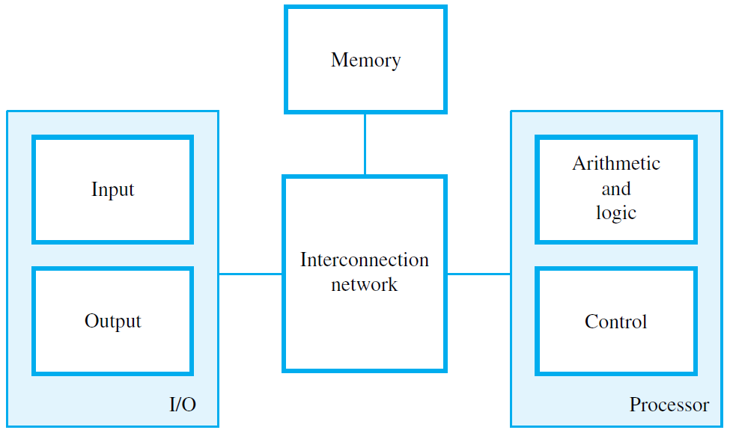
System Bus
The “heart” of the computer is the CPU or
Central Processing Unit, also called the Processor

Slide 3
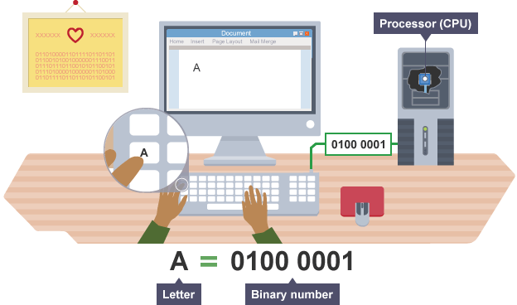
-ASCII Standard (pre defined code for certain numbers)
Binary can be converted to decimal, octal and hex for easier reading.
Notes:
When any key on a keyboard is pressed, it needs to be converted into a binary number so that it can be processed by the computer and the typed character can appear on the screen.
A code where each number represents a character can be used to convert text into binary. One code we can use for this is called ASCII. The ASCII code takes each character on the keyboard and assigns it a binary number.

Slide 4
Data Is Stored in Bits
Data on a computer is stored as binary digits (“bits” for short)
A bit holds a 1 or 0 value
A pulse of 5 volts of electricity can represent a 1 bit and a pulse of 0 volts (the absence of voltage) can represent a 0 bit
With fiber-optic cable, a 1 bit is represented by the presence of light and a 0 bit by the absence of light
A “byte” is a collection of 8 bits

Slide 5
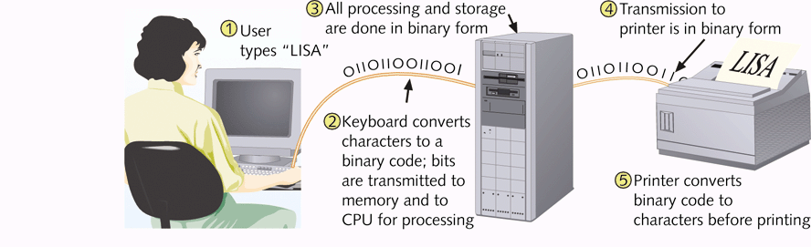

Slide 6
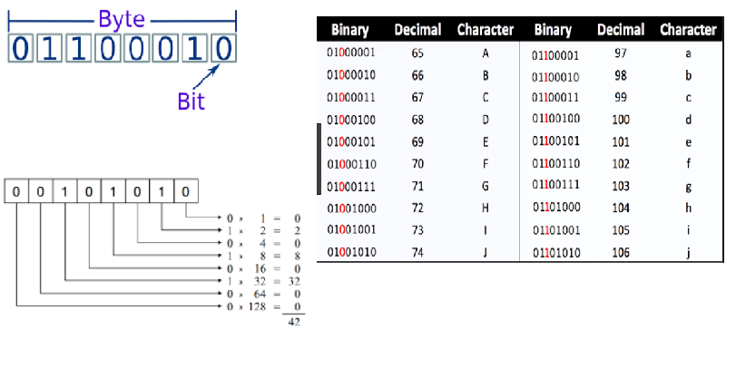
Bits and Bytes
ASCII – American Standard Code for Information Interchange

Slide 7
Functional units
Primary memory (also called Main memory) (RAM)
Organized into words of typically 32 bits
A 32-bit word contains four 8-bit bytes (32 bits / 8 = 4bytes )
A personal computer memory might have 4 Gigabytes or more
(4 Gbyte = 2² * 2³⁰ bytes)
Programs and their data must be in this memory(RAM) to be executed
Notes:
Ref:
All about MB, GB and TB: http://www.fastwebhost.in/blog/how-many-mb-1-gb-all-about-mb-gb-tb/
Convert the following:
250MB to KB
720KB to B
350GB to KB
256KB to MB

Slide 8
Functional units
Cache memory
An adjunct to the main memory, fabricated on the processor chip
Much smaller and faster than the main memory
Holds sections of the program and data currently/frequently being executed

Slide 9
Functional units
Processor
Logic circuits for performing arithmetic and logic operations on word-size data operands
Timing and control circuits for fetching program instructions and data from memory, one after another
Registers (typically 16 or 32), each of which hold one word of operand data (Typically tiny, holds info that processor will require = faster than CPU Cache)

Slide 10
Processor - Arithmetic and Logic Unit (ALU)
Most computer operations are executed in the ALU of the processor
Performs arithmetic or logic operation

Slide 11
Processor - Control Unit
[Manager of the processor]
Memory, ALU and I/O units store and process information and perform input and output operations
The operation of these units must be coordinated (this is the responsibility of the control unit)

Slide 12
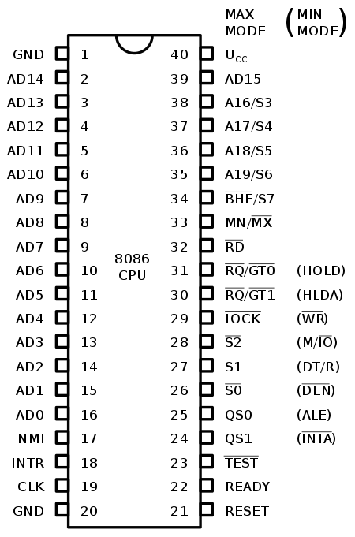
Case Study:Intel CPU 8086
All internal registers, as well as internal and external data buses, are 16 bits wide (Width of the wire. 16 wires for data buses) which firmly established the "16-bit microprocessor" identity of the 8086.
A 20-bit external address bus provides a 1 MB physical address space (2²⁰ = 1,048,576).
This address space is addressed by means of internal memory "segmentation".

Slide 13
Computer
Operation of a computer can be summarized as:
Computer accepts information in the form of programs and data through an input unit and stores it in the memory
Information stored in the memory is fetched under program control into an ALU, where it is processed
Processed information leaves the computer through an output unit
All activities in the computer are directed by the Control Unit

Slide 14
Instruction Cycle(a series of steps before a computer can complete instructions)
Although a computer system is able to run very complex programs; its own basic operation is very simple.
It derives its power by being able to repeat the basic operations billions of times per second.
A single cycle of operation, also called the instruction cycle or machine cycle, consists of Fetch, Decode, Execute, Store (Memory Access and Write Back phases)
Instructions = line of code

Slide 15
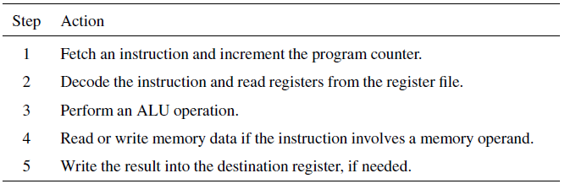
Instruction cycle operations
Fetch
Execute

Slide 16
Instructions and Programs
An instruction specifies an operation and the locations of its data operands
A 32-bit word typically holds one encoded instruction
A sequence of instructions, executed one after another, constitutes a program
Both a program and its data are stored in the main memory

Slide 17
Instruction types
Three basic instruction types:
Load - Read a data operand from memory or an input device into the processor
Store - Write a data operand from a processor register to memory or an output device
Operate - Perform an arithmetic or logic operation on data operands in processor registers

Slide 18
Example program
A, B, and C, are labels representing memory word addresses;
Ri are processor registers(Tiny amount of memory that is built onto the processor itself.)
A program for the calculation
C = A + B is: Load R2, A (Loads data at Location A into R2) Load R3, B (Loads data at Location B into R3) Add R4, R2, R3 (Does the operation [R2 + R3]) Store R4, C (Stores R4 into Location C)

Slide 19
Processor components
The program counter (PC) register holds the memory address of the current instruction
The instruction register (IR) holds the current instruction
General-purpose registers hold data and addresses
Control circuits and the arithmetic and logic unit (ALU) fetch and execute instructions

Slide 20
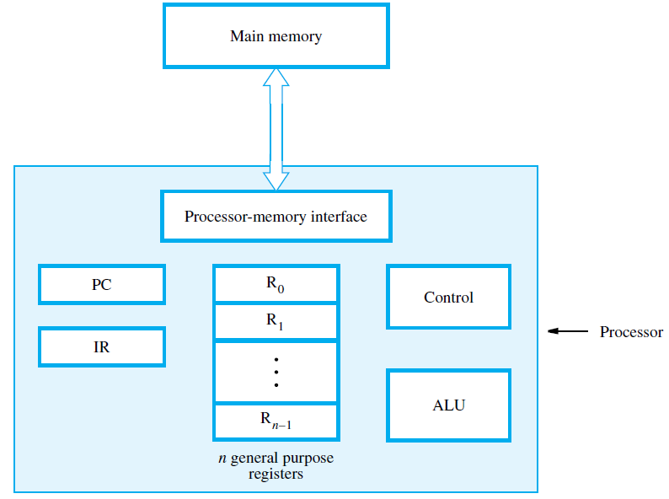

Slide 21
Fetching and executing instructions
Example: Load R2, LOC The processor control circuits do the following:
Send address in PC to memory; issue Read
Load instruction from memory into IR
Increment PC to point to next instruction
Send address LOC to memory; issue Read
Load word from memory into register R2

Slide 22
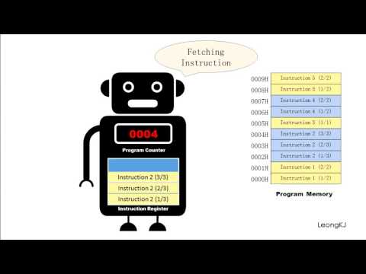
PC: Program Counter
A program counter is a register in a computer processor that contains the address (location) of the instruction being executed at the current time.
As each instruction gets fetched, the program counter increases its stored value by 1. After each instruction is fetched, the program counter points to the next instruction in the sequence. When the computer restarts or is reset, the program counter normally reverts to 0.

Slide 23
Handling I/O devices
An application program can:
Read data (such as a keyboard character) from an input device
Write data (such as letter character) to an output display screen
Sense the readiness of an input or output (I/O) device to perform a transfer (Polling and interrupt)

Slide 24
Performance
How quickly can a program be executed ?
Some factors:
Speed of electronic circuits in the processor (Clock speed)
Access times to the cache and main memory
Design of the instruction set
Number of operations that can be done at the same time (parallelism) (Multi Core)
Notes:
BIG PROBLEM: ONE SOLUTION
The rapidly increasing CPU speeds meant that the CPU would actually need to wait for the memory chip to understand the fast succession of requests it was sending out. This was a problem.

Slide 25
Technology
Improvement in the materials used of transistors means instructions can be executed faster
Improvements in process technology means more transistors can be placed on a chip (see next slide) leading to
More logic functionality
More memory storage capacity

Slide 26
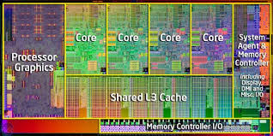
Performance - Parallelism
Multicore processors (across multiple cores)
Multiple processing units can be fabricated on a single chip.
core is used for each of these processors
the term processor is then used for the complete chip
dual-core, quad-core and octo-core processors for chips
Notes:
I zoom in of intel Sandy Bridge processor

Slide 27
You want a fast CPU for the new computer you are building and your motherboard only has one CPU socket. To increase the processing power, you need a CPU that provides more than one processor. What is this CPU called?
multicore
multiple
multifaceted
muliticast

Slide 28
Summary
Basic structure of computers - I/O, Memory, Processor with interconnection network.
Instruction cycle operations - Fetch and Execute
Performance - technology, parallelism

